Slide 1




Environmental Health Research and Community Engagement Efforts in Communities Neighboring Mining and/or Resource Extraction Sites
Iliana Manjón
Mentors: Eric Betterton, Eduardo Sáez, Mónica Ramírez-Andreotta
NASA Space Grant Symposium, April 22, 2017, Tempe, Arizona
Notes:
Hello everyone, my name is Iliana Manjon and I have been working with Dr. Betterton, Dr. Saez, and Dr. Ramirez-Andreotta this year on two project: an environmental health project and the other, a community enagement project both involving underserved communities neighboring resource and mining extractions.

Slide 2
Assessing the Capability of Plants as In-Situ Air Pollution Monitors: A Pilot Study Conducted in Arizona
Research Question:
Can leaves be used as viable low-cost air monitors for contaminants of concern?
Notes:
Mining and smelting operations may pose health risks to neighboring communities if there are elevated levels of contaminants in the air due to airborne dust.
One way to address this potential risk is by providing low-cost air monitors to these communities.
The purpose of this study was to determine which leaves submitted to Gardenroots from home gardens in Cochise and Greenlee counties in Arizona could be used as viable low-cost air monitors for contaminants of concerns.

Slide 3
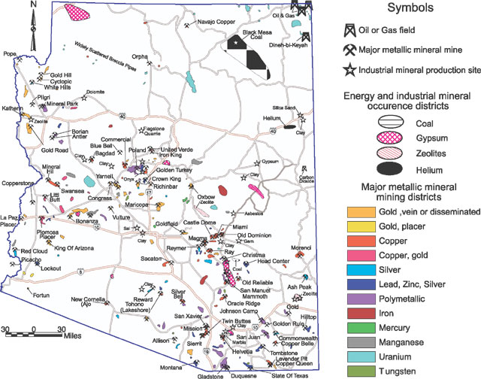
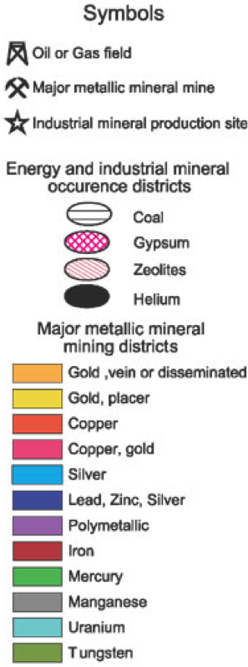
Sampling Site
This map shows current mining and resource extraction sites throughout Arizona.
Notes:
This map shows just how many sites there are in Arizona.
The samples for this study were taken from Cochise and Greenlee as indicated with the boxes from the beginning of summer to the end of fall 2015.

Slide 4
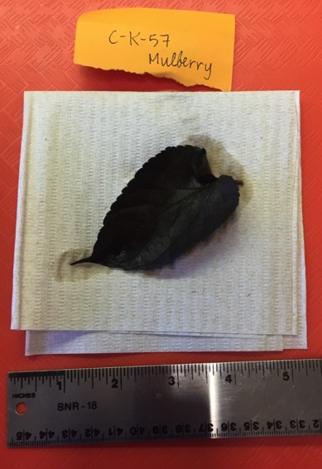
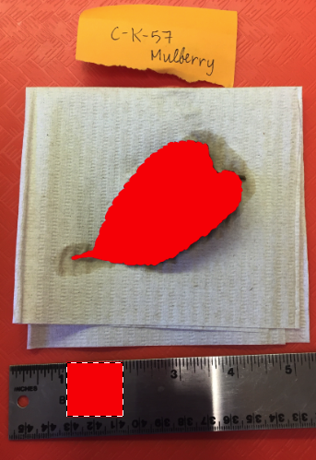
Methods
Community member submitted leaf sample
As, Cd, and Pb concentrations analyzed by ALEC
Surface area was calculated
Contaminant to Ca ratio was calculated
Estimated ambient lead concentration was calculated
Notes:
This project began in the homes of these community members.
First the community member submitted a leaf sample from their home garden to their designated Gardenroots Extension Office
Then, the samples were analyzed by the Arizona Laboratory for Emerging contaminants for 3 specific contaminants of concern: Arsenic, cadmium, and lead
As you can see in this picture, the surface area of the leaves were calculated using photoshop
Then by knowing the concentration of each of those elements, and the surface area of the leaves, I was able to calculate the surface deposition of each of those contaminants.
This then allowed me to calculate a ratio between the metal or metalloid of concern to calcium since calcium is naturally found in soils
Lastly, I was able to estimate the ambient lead concentration at the participant’s home at the time that the leaf samples were taken

Slide 5
Total leaf surface area measured from each leaf sample
Notes:
This graph shows the leaf surface area that was calculated using photoshop. As you can see, there was a vast amount of diversity among the samples that were submitted.
I would also like to point out that the rose bush and mint leaves had the smallest surface area.

Slide 6
Ratio between lead, cadmium, and arsenic deposition to calcium deposition in dust
Notes:
This graph shows the ratio between the individual contaminant of concern to the naturally ocurring calcium. This ratio indicates which leaves were better than others in collecting arsenic, lead, and cadmium. It was interesting to find that rose bush and mint leaves were among the most efficient, despite their surface area. This finding indicates that the surface area of the leaf was not the sole factor contributing to the efficiency in collecting the metals.

Slide 7
Estimated concentration of lead in the air
National Ambient Air Quality Standard (NAAQS) for lead = 0.15 μg/m³
Concentration (μg/m³)
Notes:
Lastly this graph puts the previous lead data into context in terms of air quality. It show the estimated ambient lead concentration at the time the samples were taken at the participant’s homes in cochise and greenlee counties. As you can see, none of the ambient lead concentrations based on any of these samples exceeded the National Ambient Air Quality Standard for lead set by the US EPA.

Slide 8
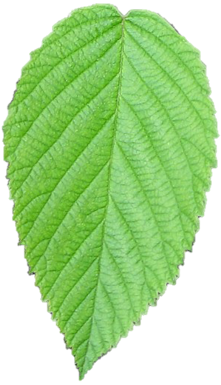
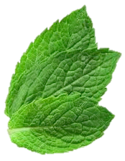
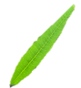
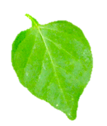
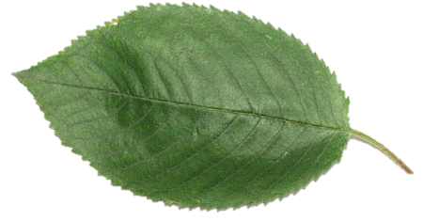
Summary of Results
Ambient concentration of lead did not exceed the NAAQS.
Most efficient leaves in capturing arsenic, cadmium, and lead were:
Chiltepin
Blackberry Bush
Rose Bush
Mint
Chaste Berry
Notes:
To summarize, the ambient concentration of lead in the participants’ gardens in Cochise and Greenlee county did not reach the US National Ambient Air Quality Standard during the time that the samples were taken. And the most efficient leaves in capturing arsenic, cadmium, and lead were. Using home garden leaves as local air monitors provide an affordable alternative to measure air pollution for residents of at-risk communities.

Slide 9
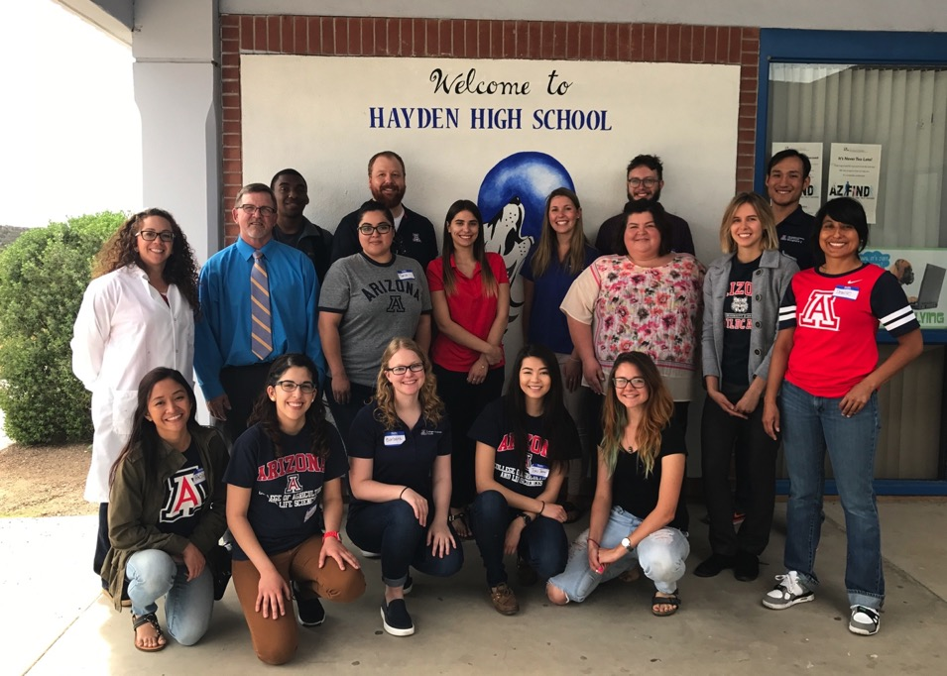
Hayden-Winkelman Unified School District Environmental Science Education Project Winkelman, AZ
Notes:
Hayden and Winkelman, AZ are two towns that would benefit from low-cost air monitors. With this second project, I worked directly with Hayden-Winkelman School District in Winkelman, AZ. This school district is composed of only 2 schools that facilitate almost 300 students in total. Last month, we had the first of many science education days as part of this Environmental Science Education Project. These are the University of Arizona volunteers with Hayden High School faculty from that event.

Slide 10
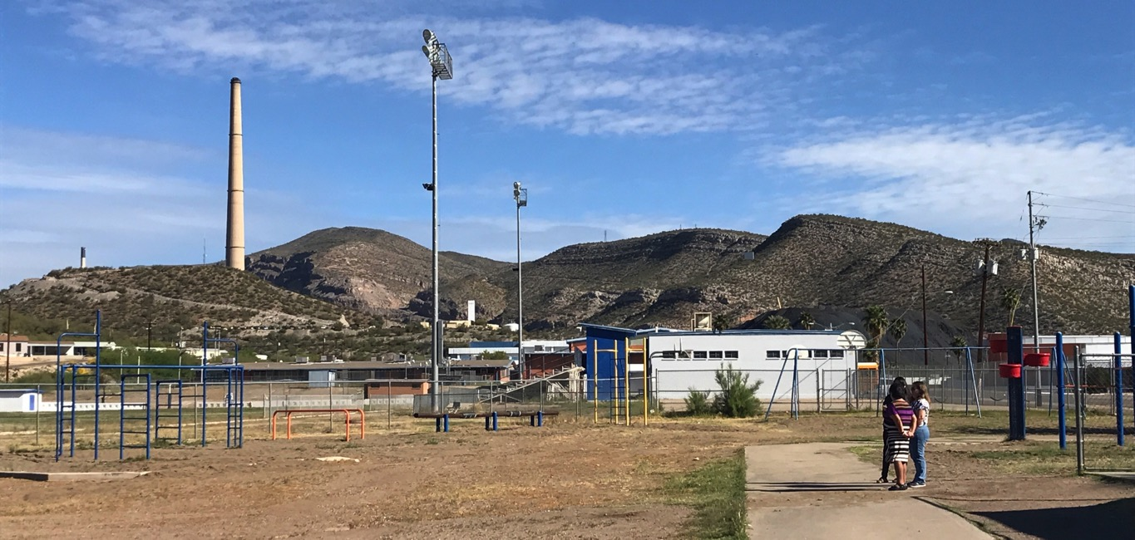
Proximity to the ASARCO Hayden Plant
Smoke stack
Slag pile
Notes:
I mentioned that communities neighboring mining operations and extraction sites are at risk of pollution. This was a picture taken from the playground of Leonor Hambly K-8 school during our first event. The mining operation neighboring these schools is the ASARCO Hayden Plant which is an active copper mine. As I’ve indicated with arrows, the smoke stack, which is essentially a 1,001 foot chimney, hovers over the town and schools. I’ve also indicated a slag pile which is a huge pile of high temperature extraction waste put there to cool down.
“The tallest free-standing structure in Arizona, 1,001 feet tall chimney”
ASARCO Hayden Plant, active copper mine with smelter, concentrator, and mine tailings.

Slide 11
In-class environmental science experiments for different age groups
(March 27th, 2017)
Future Plans
Goal
Implementation
Future Events
Science Night
(April 26th, 2017)
build a water harvesting system and garden
(Fall 2017)
Implement community-engaged research projects and water harvesting education at Hayden-Winkelman USD for grades K-12

Slide 12

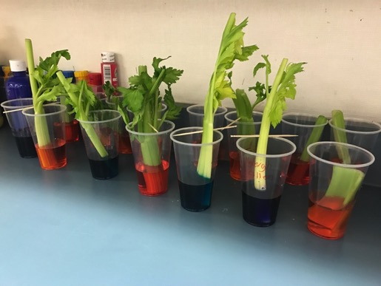
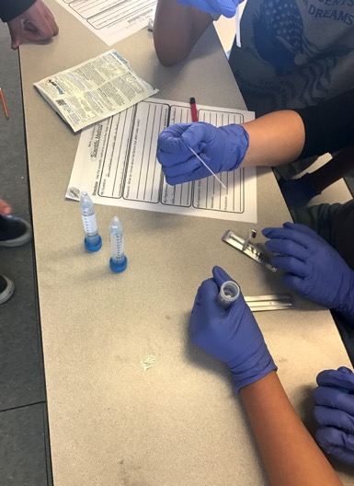
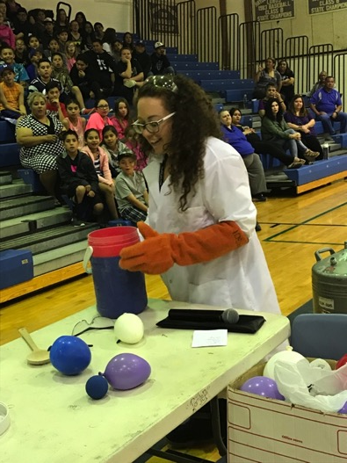

Slide 13


Acknowledgements
A sincerest thank you to:
My mentors
Arizona Space Grant Consortium
Dust Group
Gardenroots participants
HWUSD students and faculty
Integrated Environmental Science and Health Risk Laboratory
Arizona Laboratory for Emerging Contaminants
Science Day volunteers

Slide 14
Thank You

Slide 15
References
ATSDR. ”TOXICOLOGICAL PROFILE FOR LEAD." (n.d.): n. pag. Aug. 2007.
Web. 7 Apr. 2017. <https://www.atsdr.cdc.gov/toxprofiles/tp13.pdf>.
"National Ambient Air Quality Standards (NAAQS) for Lead (Pb) Fact Sheets
and Additional Information." EPA. Environmental Protection Agency,
26 Sept. 2016. Web. 07 Apr. 2017. <https://www.epa.gov/lead-air-
pollution/national-ambient-air-quality-standards-naaqs-lead-pb-fact-
sheets-and-additional>.
"Simple Steps to Start Collecting." Simple Steps to Start Collecting. University
of Arizona, n.d. Web. 07 Apr. 2017. <https://gardenroots.arizona.edu/
get-started>.
Notes:
https://www.epa.gov/sites/production/files/2016-09/documents/pb_naaqs_nfr_fact_sheet.pdf
https://gardenroots.arizona.edu/get-started
https://www.atsdr.cdc.gov/toxprofiles/tp13-c6.pdf

Slide 16
Methods
1. Community member submitted their leaf samples via Gardenroots
2. The leaves were agitated in nano-pure water for 24 hours, then the aqueous solution was filtered
3. Elemental concentration of arsenic, cadmium, and lead within the solution were analyzed at Arizona Laboratory for Emerging Contaminants (ALEC)
4. A photograph was taken of each pressed leaf sample
5. The surface area of the leaf samples was calculated by using a metric reference on Adobe Photoshop CS5 Extended (San Jose, CA)
6. The surface deposition of each element from the dust was calculated and compared to calcium
7. Estimated lead concentration in the air was calculated using the surface flux and deposition velocity of lead
Notes:
ICP-MS

Slide 17
Application of lead data
Surface deposition of lead ÷
atmospheric residence time (ATSDR)
Surface Flux
Deposition Velocity
= Estimation of lead concentration in air
0.006 m/s (ATSDR)

Slide 18
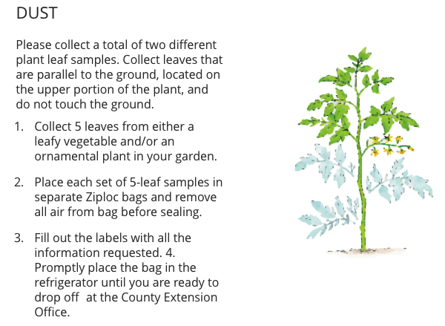
Participant sample collecting protocol
Source: https://gardenroots.arizona.edu/get-started
Notes:
The goal of Gardenroots is to “Evaluate environmental quality and the potential exposure to contaminants of concern (COC) near active or legacy resource extraction and hazardous waste sites and successfully reportback to participants the results of their study”

